Slide 1
Hiring manager – requisition creation in workday (intern/Co-op)
August 2019
University Relations

Slide 2
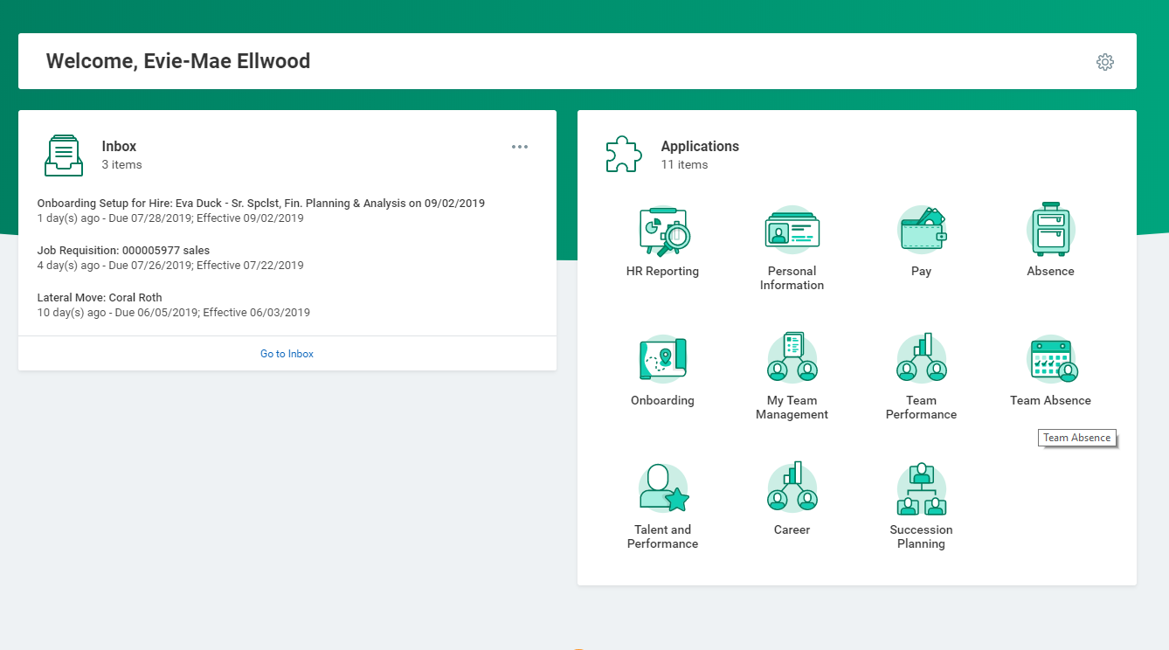

Slide 3
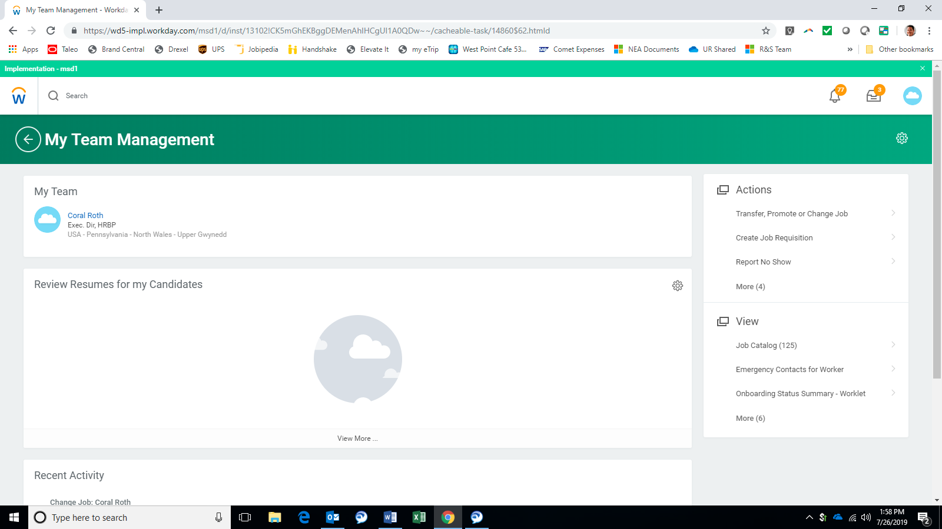

Slide 4
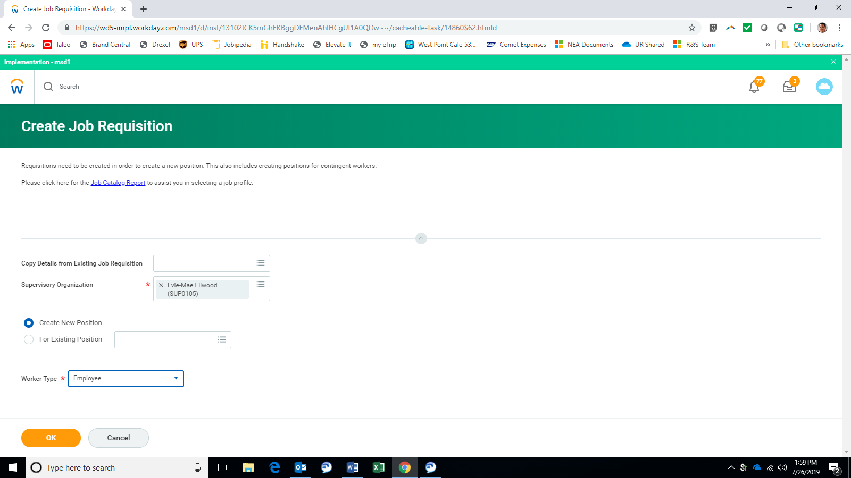

Slide 5
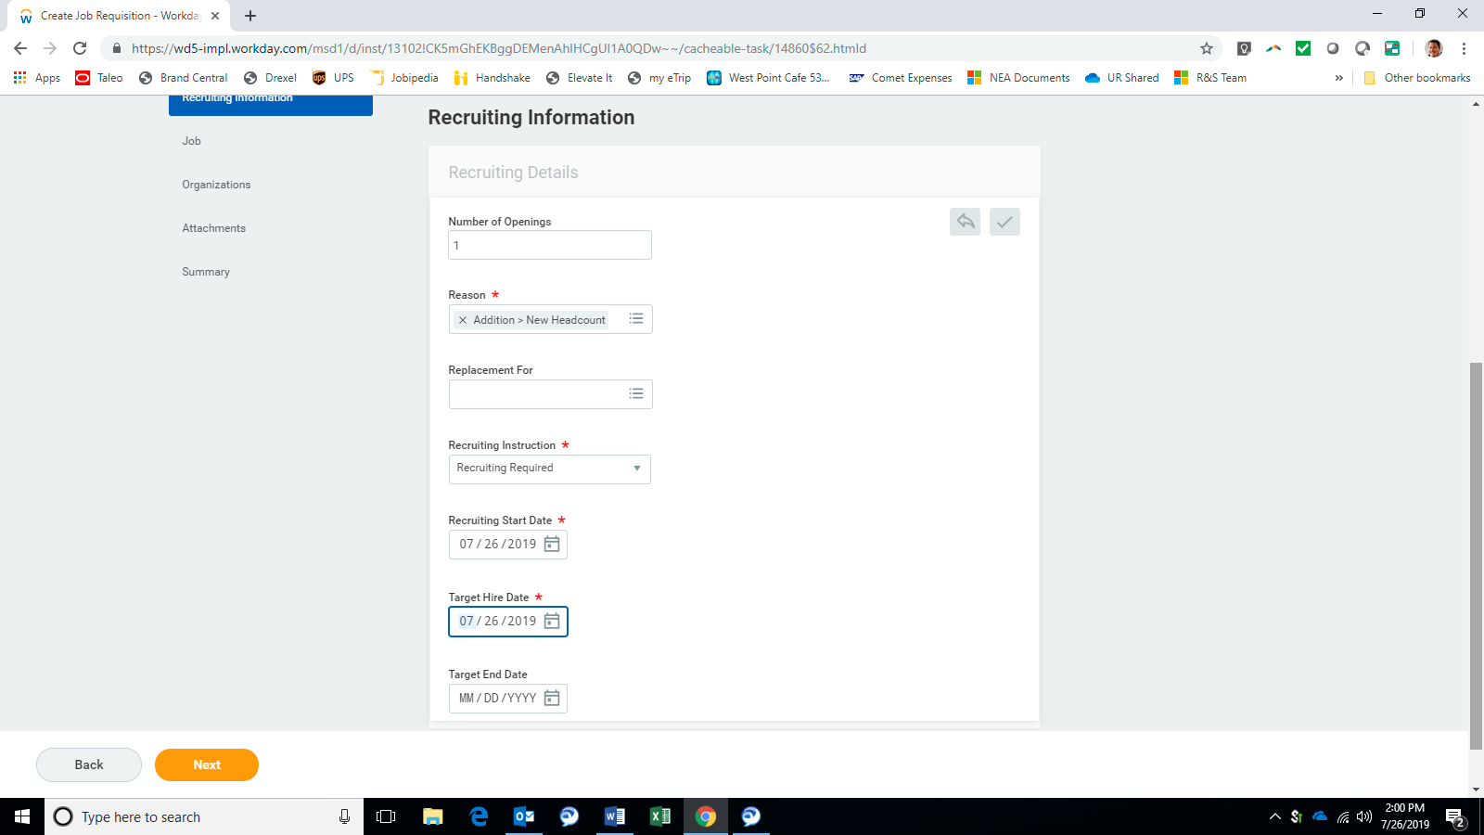
Cannot add positions later – can delete if needed.
Select Addition – New Headcount
Must select Recruiting Required to flow to GTA
Today’s date
Today’s date
Must enter target end date for interns / co-ops

Slide 6
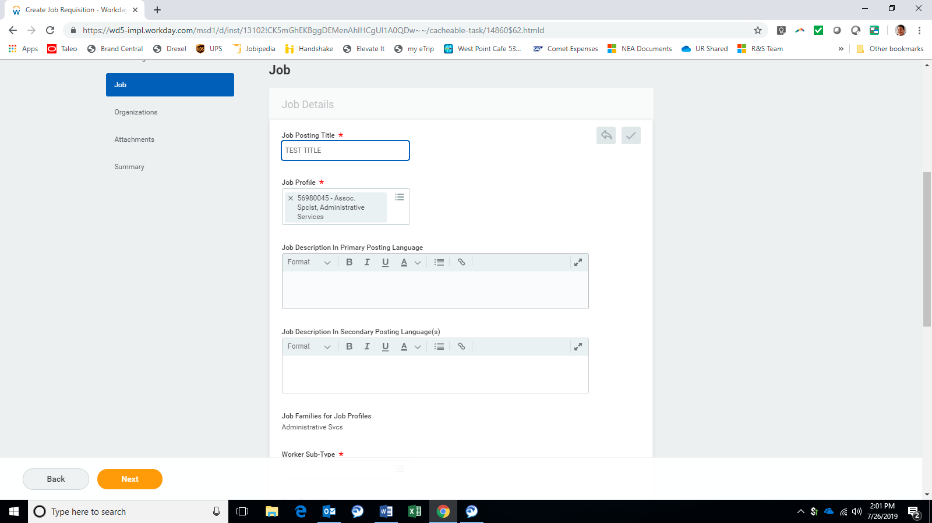
ALL interns / co-ops should use 56980045 job profile

Slide 7
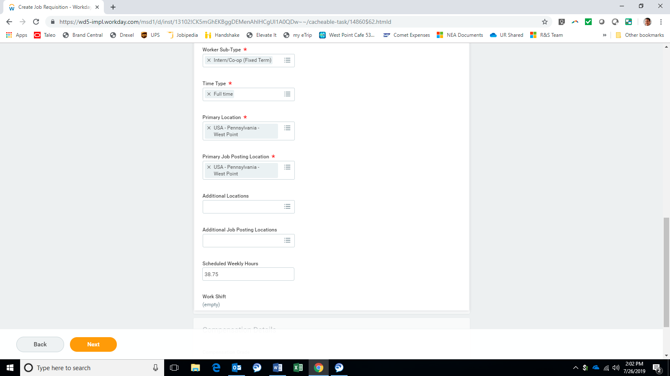
ALL interns / co-ops should be intern / co-op (fixed term)
ALL interns / co-ops should be full-time
Choose primary location
Auto-populated
Add all secondary locations
ALL interns / co-ops should be 38.75 hours

Slide 8
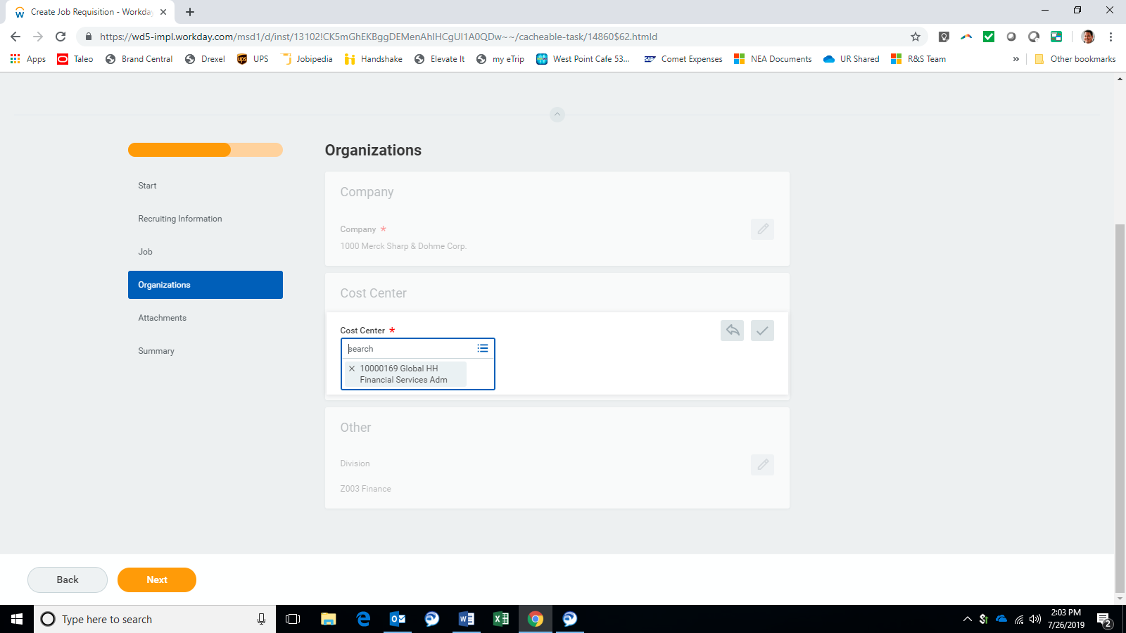
Adjust cost center if needed

Slide 9
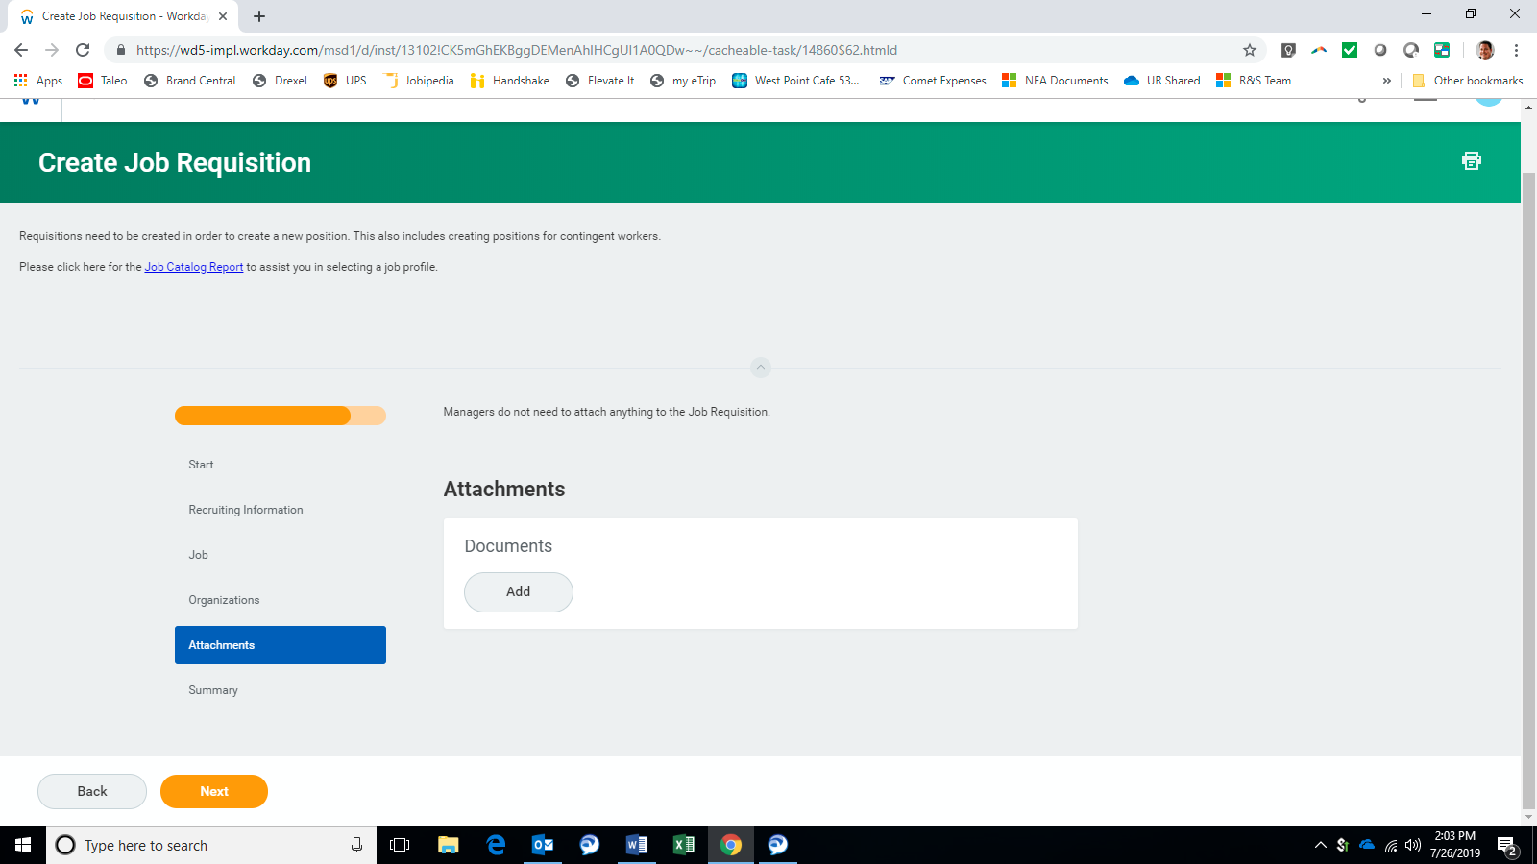
Nothing needed on this screen

Slide 10
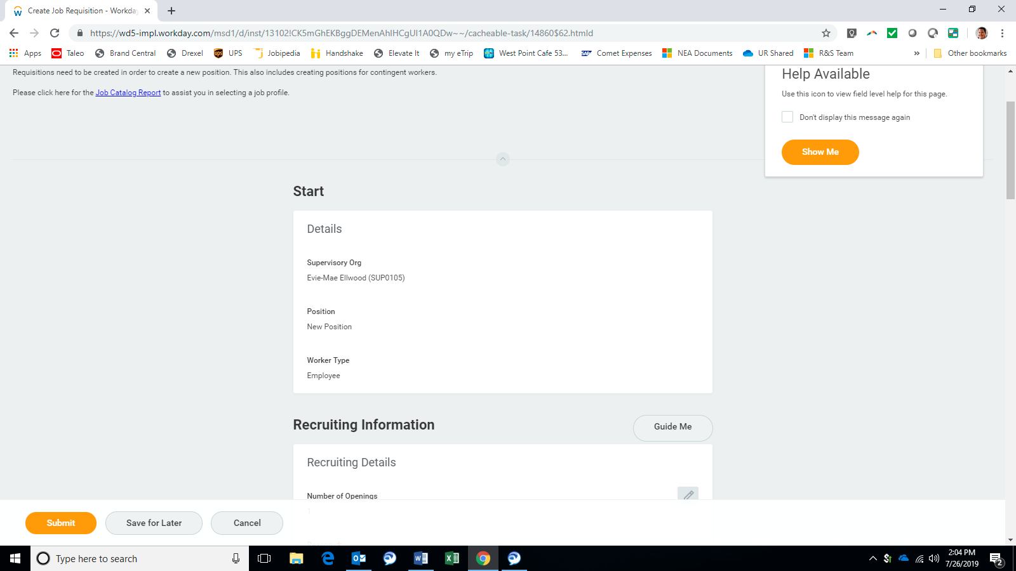
Review and submit!

Slide 11
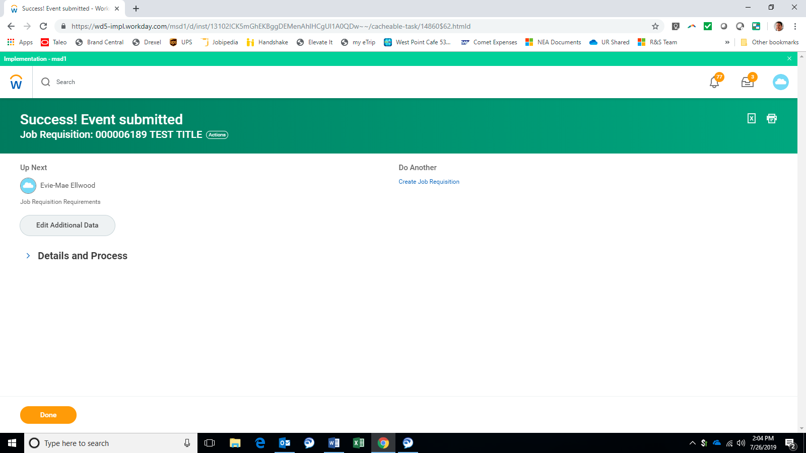
NOT DONE YET!!!!! Must click “Edit Additional Data” to complete the creation process!

Slide 12
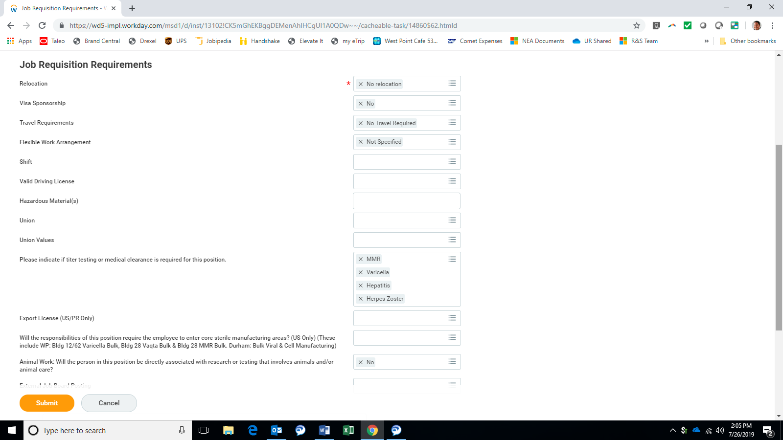
Review and submit!

Slide 13

Success! Off to +1 for final approval.

